Slide 1






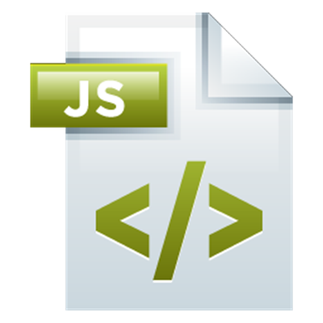

Iterators and Generators
Iterators, Iterables, Generator Functions, Function*, Yield
Iterators and Generators
function*
SoftUni Team
Technical Trainers
Software University
http://softuni.bg

Slide 2



Table of Contents
Iterators in JS
Iterables
Generator Functions
Spread Operator: …items

Slide 3
Have a Question?
sli.do #js-gen

Slide 4
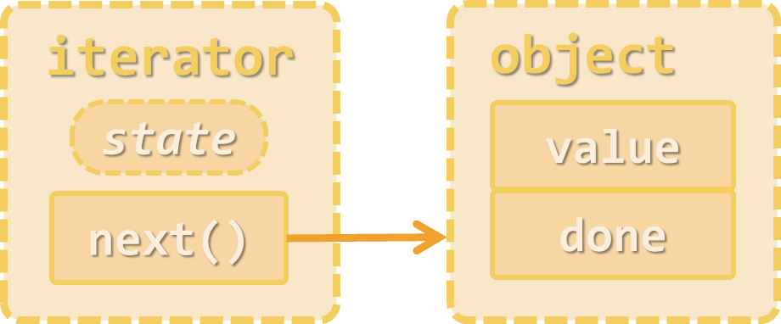
Iterators
Writing Iterator Functions

Slide 5

What is Iterator?
Iterator is an object designed to pass through all elements of a collection (to enumerate a collection)
In JS iterators are objects having function next()
next() returns an object holding value and done (Boolean)
iterator
object
state
value
next()
done
collection of objects

Slide 6
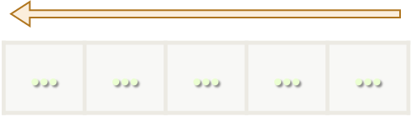
Iterator – Reverse Array Example
function reverseArrayIterator(arr) {
let index = arr.length-1;
return {
next: function() {
if (index >= 0)
return { value: arr[index--], done: false };
else
return { done: true };
}
}
}
Check your solution here: https://judge.softuni.bg/Contests/345

Slide 7

Using an Iterator – Enumerating All Items
let arr = [10, 20, 30];
let iterator = reverseArrayIterator(arr);
while (true) {
let item = iterator.next();
if (item.done) break;
console.log(item.value);
}
for (let item of reverseArrayIterator(arr))
console.log(item);
// TypeError: reverseArrayIterator(...)[Symbol.iterator] is not a function

Slide 8

Iterables in JS
for (let item of iterable) …
Using for … of for User-Defined Objects

Slide 9
What is Iterable?
Iterable is an object that holds an iterator object under a key Symbol.iterator
Iterables can be enumerated in for … of loop
iterator
object
iterable
state
value
[Symbol.iterator]
next()
done

Slide 10
Iterable – Reverse Array Example
function reverseArrayIterable(arr) {
let index = arr.length-1;
return {
[Symbol.iterator]: function() { return this; },
['next']: function() {
if (index >= 0)
return { value: arr[index--], done: false };
else
return { done: true };
}
}
}
Check your solution here: https://judge.softuni.bg/Contests/345

Slide 11
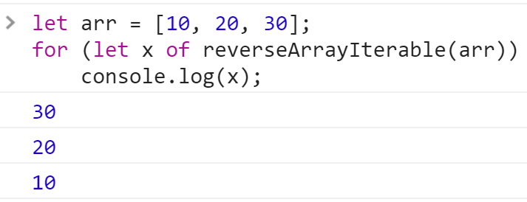
Using an Iterable – Enumerating All Items
let arr = [10, 20, 30];
for (let x of reverseArrayIterable(arr))
console.log(x);

Slide 12
Generator Functions in JS
function*

Slide 13
What is Generator Function?
Generator functions in JS produce a sequence of values
Maintain internal state and yields values one by one
Dramatically simplifies how we write iterables
Each call produces a new value (until the sequence is finished)
function* oddNums() {
let num = -1;
while (true)
yield num += 2;
}
let g = oddNums();
for (let i=0; i<10; i++)
console.log(g.next());
This is an infinite generator

Slide 14
Generator Function – Reverse Array Example
function* reverseArrayGenerator(arr) {
for (let i = arr.length-1; i>=0; i--)
yield arr[i];
}
let arr = [10, 20, 30];
for (let x of reverseArrayGenerator(arr))
console.log(x);
Check your solution here: https://judge.softuni.bg/Contests/345

Slide 15
Problem: Iterate over HTML Tags
Write a generator function to accept HTML text and extract all tags from it
function* extractTags(html) { … }
let html = `<html><body>
<p align='center'><span lang='en'>Hello</span>, HTML
</p> Bye, bye</body></html>`;
for (let tag of extractTags(html))
console.log(tag);
<html>
<body>
<p align='center'>
<span lang='en'>
</span>
</p>
</body>
</html>

Slide 16
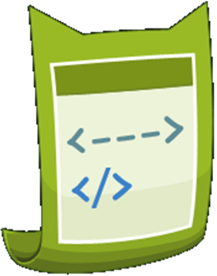
Solution: Iterate over HTML Tags
function* extractTags(html) {
let regex = /<[^>]+>/g;
let match;
while (match = regex.exec(html)) {
let tag = match[0];
yield tag;
}
}
Check your solution here: https://judge.softuni.bg/Contests/345

Slide 17
Spread Operator in JS: …items
… | … | … | … | …
… | … | … | … | …

Slide 18
The Spread Operator "…"
The spread operator "…" expands an expression by its iterator
Used where multiple values are expected
let arr = [10, 20, 30];
let newArr = [0, ...arr, 40, 50];
console.log(newArr); // [0, 10, 20, 30, 40, 50]
let values = [10, 5, 100, 30, -7];
console.log(Math.max(...values)); // 100
let dateInfo = [2016, 2, 27];
console.log(new Date(...dateInfo)); // Sun Mar 27 2016

Slide 19

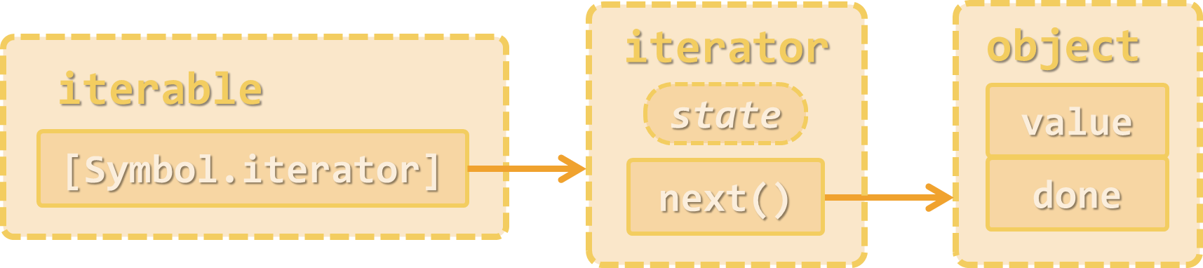
Practice: Iterators and Generators
Live Exercises in Class (Lab)

Slide 20
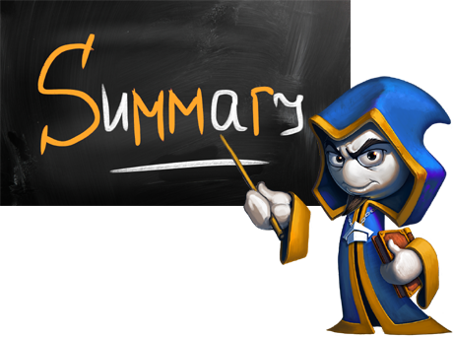

Summary
Iterators iterate through a collection of values
Function next() → { value, done }
Iterable objects hold an iterator under a key Symbol.iterator
Generator functions implement iterators smartly
function* gen(max) {
for (let i = 0; i <= max; i += 10)
yield i;
}
for (let x of gen(50)) console.log(x);

Slide 21









Iterators and Generators
https://softuni.bg/courses/javascript-advanced

Slide 22
License
This course (slides, examples, demos, videos, homework, etc.) is licensed under the "Creative Commons Attribution-NonCommercial-ShareAlike 4.0 International" license

Slide 23






Free Trainings @ Software University
Software University Foundation – softuni.org
Software University – High-Quality Education, Profession and Job for Software Developers
softuni.bg
Software University @ Facebook
facebook.com/SoftwareUniversity
Software University @ YouTube
youtube.com/SoftwareUniversity
Software University Forums – forum.softuni.bg

